Slide 1
“CHINA MARY”: FEMALE CHINESE-Heritage PIONEERS AT THE TOP OF US PROFESSION
YA-CHEN CHEN, PH.D.

Slide 2
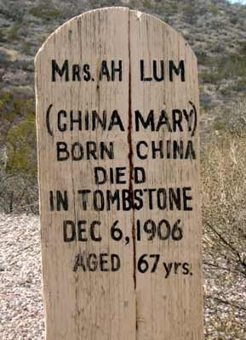
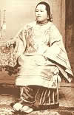
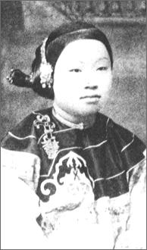
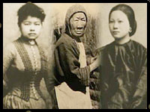
CHINA MARY
First Chinese woman
The Sandalwood Mountains:
Afong Moy 1837
Hawaii government:
Lady of Ayum 8/19/1855
Hawaii Commissioner of Immigration
William Hillebrand:
473 men and 52 women from China 1865
(unbalanced ratio: “Bachelor’s society”)

Slide 3
Chinese-Heritage Women Immigrants’ History:
1. 1840s-1943
(Chinese Exclusion Act: 1882-1943)
2. 1943-1965
(Title VII and EEOC: 1964)
3. 1965-1990s & PRESENT

Slide 4
UNBALANCED RATIO: THE CHINESE AMERICAN “BACHELOR’S SOCIETY”
YEARS | RATIO
1860 | 18:1
1870 | 13:1
1890 | 27:1
1900 | 26:1

Slide 5
CHANGES OF LEGAL TARGETS: CHINESE OR ASIAN WOMEN IN THE US
YEARS | LAWS
1870 | PAGE ACT: “GOOD STANDING” PAPERWORK
1924 | NO ASIAN-HERITAGE WOMEN’S ENTRANCE
1947 | WAR BRIDE ACT: OVER 6000 FOREIGN WIVES IN 1947-1950

Slide 6
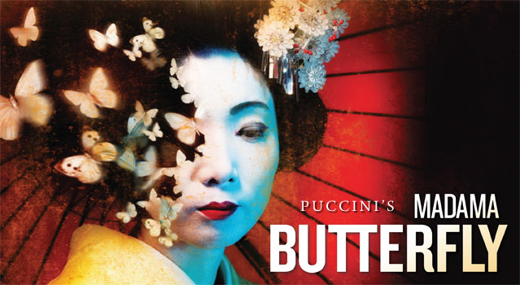
US MISCONCEPTION ABOUT ASIAN WOMEN TOGETHER WITH THE WAR BRIDE ACT
MADAME BUTTERFLY
MISS SAIGON
SUZIE WONG
MODEL MINORITY
GLASS CEILING/BAMBOO CEILING

Slide 7
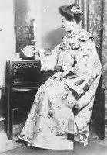
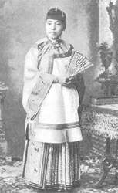
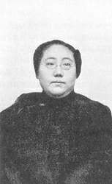
US’s Earliest Female Chinese-Heritage Medical Students and Doctors *金雅妹1864-1934 *許金訇1866-1926 *康愛德1873-1931 *石美玉1873-1954

Slide 8
TYE LEUNG SCHULZE (1888–1972)
FIRST FEMALE CHINESE INTERPRETER & ASISTANT TO THE MATRON AT THE ANGEL ISLAND IMMIGRATION STATION IN 1910
National Women's History Month Honoree
FIRST VOTING EXPERIENCE ON MAY 19,1912
(Note: Emma Hoo Tom & Clara Chan Lee 1911)
LOSS OF JOB (REASON: ROMANTIC RELATION WITH A CAUCASIAN; CA Legal Prohibition of Inter-racial Marriage between Asians and Caucasians: 1906-1948 )

Slide 9
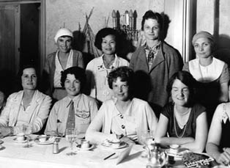
EARLIEST FEMALE CHINESE-HERITAGE AVIATORS
張瑞芬
Katherine Sui Fun Cheung 1904-2003
李月英
Hazel Ying Lee 1912-1944
朱美嬌
Maggie Gee
1923-present

Slide 10
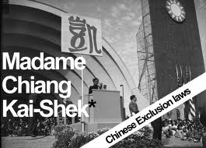
CHINESE FIRST LADY: SPEECH AT THE US CONGRESS in 1943
宋美齡
Soong, Mei-ling
1897-2003

Slide 11
CHINESE-HERITAGE WOMEN ON THE US SCREEN
黃柳霜Anna May Wong 1905-1961
關家蒨 Nancy Kwan b. 1935
陳蒂娜 Tina Chen
溫明娜 Ming-NA Wen b. 1963
李萊拉 Lela Lee b. 1974
李矇(駱家輝之妻)
Mona Lee (Gary Locke’s Wife)
宗毓華 Connie Chung
潘貝思 Bertha Bay-Sa Pan
白靈 Bai Ling b. 1966
劉玉玲 Lucy Liu b. 1968
崔明慧 Christine Choy

Slide 12
FIRST FEMALE CHINESE-HERITAGE WINNER IN US ELECTIONS
MARCH FONG EU

Slide 13
FIRST FEMALE CHINESE-HERITAGE MEMBER OF THE US CABINET
ELAINE
HSIAO-LAN
CHAO

Slide 14
FIRST FEMALE CHINESE-HERITAGE CHIEF TO THE US FIRST LADY
CHRISTINA
(TINA)
TCHEN

Slide 15
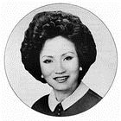
FIRST FEMALE CHINESE-HERITAGE MAYOR IN US HISTORY
LILY
WAN-RO
LEE CHEN

Slide 16
US’S FIRST CHINESE-HERITAGE CONGRESSWOMAN
JUDY CHU

Slide 17
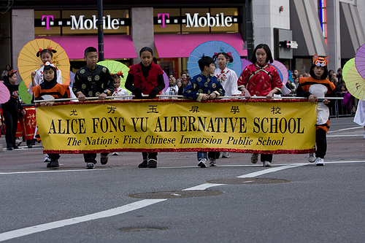
US’S First Female CHINESE-HERITAGE PUBLIC SCHOOL TEACHER
ALICE FONG YU
(1905-2000)

Slide 18
FIRST FEMALE CHINESE-HERITAGE DEPARTMENT CHAIR IN US HIGHER EDUCATION
ROSE HUM LEE
(1904-1964)
DEPARTMENT CHAIR OF SOCIOLOGY
AT ROOSEVELT UNIVERSITY IN CHICAGO IN 1956

Slide 19
DAUGHTER OF THE WORLD’S FIRST FEMALE CHINESE PROFESSOR
E-TU ZEN

Slide 20
FIRST FEMALE CHINESE-HERITAGE MEMBER ON THE NATIONAL COUNCIL OF THE ART APPOINTED BY US PRESIDENT BUSH
CATHERINE YIYU
CHO WOO

Slide 21
PRESIDENT OF ACLS (American Council of Learned Society)
PAULINE YU

Slide 22
ASIAN STUDIES HEAD, LIBRARY OF CONGRESS
MI CHU WIENS

Slide 23
Phylis Lan Lin Day IN INDIANAPOLIS
PHYLIS LAN LIN

Slide 24
CREATER oF THE FIRST COLLEGE-LEVEL ASIAN AMERICN STUDIES CLASSES IN THE EAST OF THE US
BETTY LEE SUNG

Slide 25
Founder & President OF The Society for Chinese American Studies
Bernadette Yu-Ning Lee

Slide 26
CREATER OF THE ASIAN PACIFIC RIM STUDIES IN US ACADEMY
LUCIE CHENG

Slide 27
US’S FIRST FEMALE TAIWAN-HERITAGE ATTORNEY
MARIAN S. K. MING

Slide 28
DESIGN FOR THE VIETNAMESE VETERAMS MEMORIAL IN WASTHINGTON DC & THE National Women's Hall of Fame in Seneca Falls
MAYA LIN

Slide 29
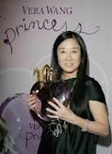
FEMALE CHINESE-HERITAGE FASHION DESIGNER IN THE US
VERA WANG

Slide 30
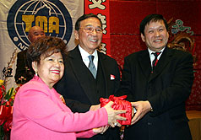
US’S QUEEN OF ASIAN CANTERING ENTERPRISE
YA-FENG CHANG
張亞鳳

Slide 31
WELL-ANTHOLOGIZED FEMALE CHINESE-HERITAGE WRITERS IN THE US
Sui Sin Far (Edith Maude Eaton）
Jade Snow Wong 黃玉雪
Yu Lihua 於梨華
MAXINE HONG KINGSTON 湯婷婷
AMY TAN 譚恩美
Gish (Lillian) Jen 任璧蓮
Sandra Tsing Loh
Shirley Geok-lin Lim

Slide 32
OTHERS
Margaret Chin
(the first female Chinese American member of NYC Council to represent the Manhattan Chinatown area)
Grace Meng
(so far the youngest Chinese-American assemblywoman in New York)
Lisa A. Wong
(Massachusetts’s first female Chinese-heritage mayor and so far the US’s second youngest Chinese-heritage mayor)
Jean Quan
(the US’s first female Chinese-heritage mayor of a large and major city)
Chia-lin Pao Tao
(Winner of Life-Long Achievements in Southwestern Branch of the Association for Asian Studies and Successful Lawsuit against Discrimination in the University of Arizona)
MORE FEMALE CHINESE-HERITAGE PIONEERS AT THE TOP OF US PROFESSION

